Slide 1
TDR Ch4 (updates)

Slide 2
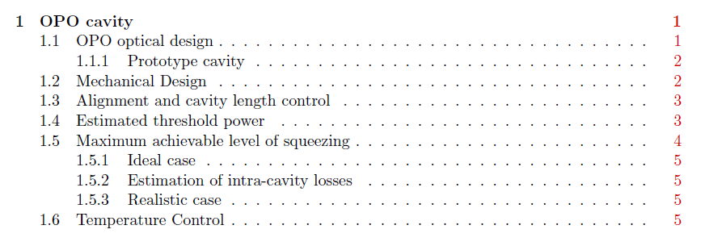
1.1 Paramaters of the final cavity added (same parameters of GEO)
1.2 Already discussed
1.3 To be detailed
1.4 To discuss today
1.5 To discuss today
1.6 To be completed with the final configuration and the final results

Slide 3




TOO LOW!!!
For GEO is about 60 mW

Slide 4
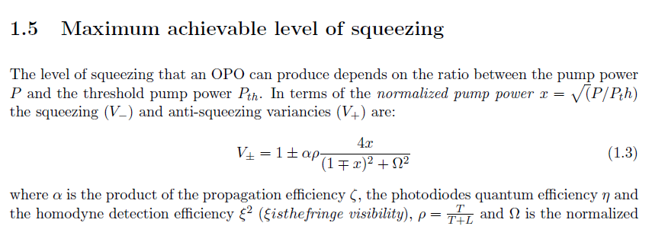


Slide 5

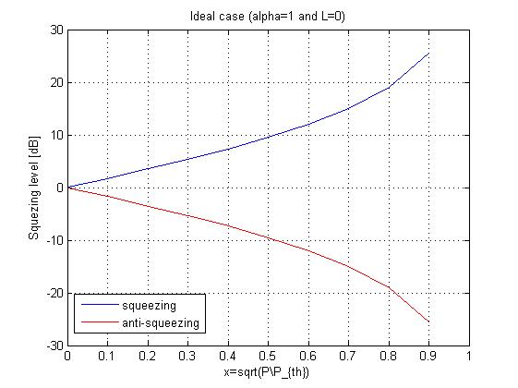

Slide 6

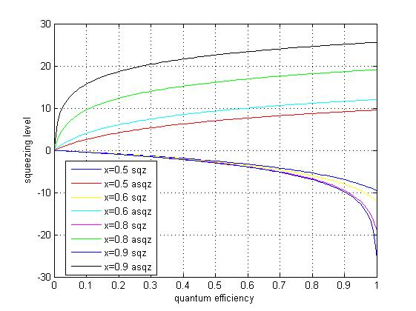

Slide 7

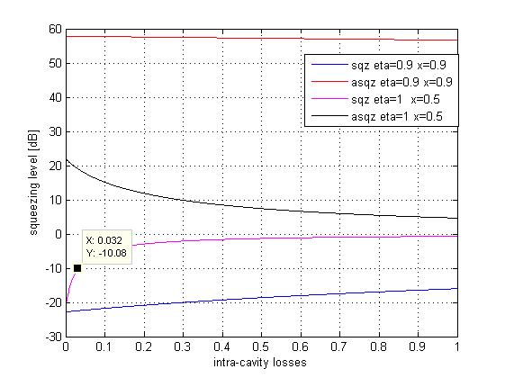

Slide 8

