Slide 1



SAT Control System
Weekly Meeting
February 28th, 2012

Slide 2
Meeting Agenda
Status Report
Coil Driver (all)
LVDT (all)
AOB

Slide 3
Channels
Analog Domain
Digital Domain
Accel
2 OUT + 1 IN
(1 channel)
2 DA+ 2 AD
channels
LVDT
2 OUT + 2 IN
(2 channels)
2 DA+ 2 AD
channels
LVDT
CD
1 OUT
(1 channel)
2 DA+ 2 AD
channels

Slide 4
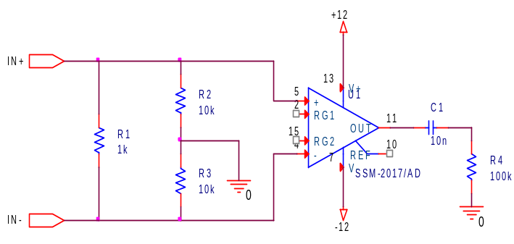
LVDT Block Diagram
AD8397
(Dual High Current)
Data Conversion Block
LVDT
DSP
Block
FPGA
DAC
Balanced Driver with
Diff Input
G=2
Vp –Vn > 14V
P
Ch1
PCIe
S
Ch2
Bal OUT
SRIO
ADC
LVDT
ADC
OPA1612
(Dual Low Distortion)
P
Diff IN
20nV/sqrt(Hz)
Fully Diff
G=1:10
Vp –Vn > 10V
S
OLD
SSM2017
G = 100:1000
HiZ

Slide 5
Communications
DAQ
TOLM
Locking / Align
Link
PCI
FPGA
FPGA
Analog IO
SA
PCIe
PCIe
HyperLink
DSP
DSP
Eth
SRIO
Eth
USB
USB

