Slide 1

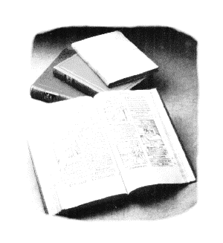
VESB NEWS
Viviana Fafone and Roberto Passaquieti for the VESB
VIR-0360A-17

Slide 2

NEXT CONFERENCES
7th Iberian Gravitational Wave Meeting (IGWM2017) (Bilbao, Spain, May 15-17)
  Nicolas Sanchis-Gual: On the gravitational wave emission from relativistic non-convex hydrodynamics
  Isabel Cordero-Carrión: On the convexity of relativistic ideal magneto-hydro-dynamics
  Alejandro Torres: Strategy for Classification of Noise Transients in Advanced Detectors
  Marica Branchesi: Unveiling the physics of the transient sky through gravitational-wave and electromagnetic observations
Kagra International Workshop (Taipei, Taiwan: May 21-22)
  Jo Van Den Brand (invited): Status of Advanced Virgo
    Seminar at HEP Department National Central University (Taiwan): Gravitational waves: physics at the extreme
Collaborative Conference on Gravitational Waves (Jeju, Korea: May 22-26)
  Pia Astone: titleTBD
International Symposium on Gravitational Waves (ISGW2017) (Bejing, China: May 25-29)
  Rosario De Rosa: The Advanced Virgo detector for gravitational waves: status and perspectives

Slide 3
NEXT CONFERENCES
Gravitational Wave Physics and Astronomy Workshop (GWPAW 2017) (Annecy, France: May 30- June 02)
  Philippe Bacon: Enhancing un-modeled gravitational wave searches sensitivity with Wavegraph
  Yann Bouffanais: A Riemann manifold Hamiltonian Monte Carlo (RMHMC) for binary neutron star parameter estimation
  Marica Branchesi: The ongoing EM alert program and prospect for joint data analysis
  Nelson Christensen: Searching for the Stochastic Gravitational-Wave Background with Advanced LIGO and Advanced Virgo
  Sabrina D'Antonio: An improved semi-coherent follow-up method for Frequency Hough all-sky candidates
  Walter Del Pozzo: Results and prospect for testing GR
  Paola Leaci: The detection of Continuous Gravitational Waves in the Advanced Detector Era
  Ornela Juliana Piccinni: Setting up a direct search for Continuous Wave signals using the Band Sample Data collection
  Maria Concetta Tringali: Extracting the post-merger gravitational wave signal from binary neutron stars.
Generation-GW: Diving into Gravitational Waves (Virgin Island, US: June 05-09)
  Barbara Patricelli: Prospects for joint GW, high-energy and very high-energy EM observations of binary neutron star mergers
MetroAeroSpace (Padua, June 21-23)
  Speaker from Trento-Padua Group

Slide 4
NEXT CONFERENCES
European Week of Astronomy and Space Science (EWASS -Prague: June 26-30)
  Massimiliano Razzano: Prospects for joint observations of gravitational waves and high-energy photons from merging binary neutron stars
  Samaya Nissanke: Follow the chirp and roar: characterising compact object mergers with gravitational waves and electromagnetic measurements
  Jose Antonio Font: Core collapse supernovae
EPS Conference on High Energy Physics (Venice: July 05-12)
  Nicolas Arnaud: Status of the Advanced LIGO and Advanced Virgo Detectors
  Giancarlo Cella: Stochastic GW searches and Cosmology with GWs
  Claudia Lazzaro: GW transient searches to probe Neutron star physics
  Cristiano Palomba: The search for continuous Gravitational Waves with LIGO and VIRGO detectors
  Edward Porter: Results of transient GW searches with Advanced LIGO
  Michele Punturo: TBD
The International Pulsar Timing Array (IPTA) (Sèvres, FR: July 03-07)
  M. Barsuglia (invited): LIGO-VIRGO
Twelfth Edoardo Amaldi Conference on Gravitational Waves (Pasadena: July 09-14)
  Giovanni Losurdo (invited): current state of Gravitational Wave Observing
Balaton Summer School in Physics (Lake Balaton-HU: July 17-23)
  Franco Frasconi (invited): title TBD (AdV suspensions)
  Eric Genin (invited): title TBD (AdV ITF)

Slide 5
NEXT CONFERENCES
TAUP 2017(Subdury, ON, Canada: July 24-29)
  Antonino Chiummo: Advanced Virgo Status (for the Virgo Coll.)
18th Lomonosov Conference (Moscow: Aug. 20-30)
  Jo Van den Brandt: title TBD
  Walter Del Pozzo: title TBD
The amazing life of stars: from the Main Sequence to the GW emission (Cefalù, Sicily: Sept. 04-08)
  Fulvio Ricci (invited): AdV status
  Giulia Stratta (invited): EM counterparts of GW detections
  Gianluca M. Guidi (invited): The future astrophysics of GW
Italian Physical Society (SIF) (Trento, ITA: Sept. 11-15)
  Francesco Fidecaro (invited): status of Advanced Virgo
  G.ovanni Losurdo (invited): Advanced Virgo
  Lorenzo Aiello: Update on the commissioning of the thermal compensation system for Advanced Virgo
  Matteo Di Giovanni: Robust estimation of the waveform of gravitational wave transients signals by a general method.
  Massimiliano Razzano: Multimessenger astrophysics in the era of gravitational waves: first results and perspectives
Spanish-Portuguese Relativity Meeting (EREP 2017) (Malaga, Spain: Sept. 12-15)
  Isabel Cordero-Carrión: On the convexity of relativistic ideal magnetohydrodynamics and the associated gravitational wave emission

Slide 6
INVITED TALKS - Rules
Virgo Collaboration Publication and Presentation Rules (VIR-0335C-13.pdf )
  3.5.1 Speaker selection:
  The invitation received by members of the Collaboration, to present Virgo or parts of it, shall be forwarded to the VEB. In order to ensure a fair distribution of talks to individuals and institutions, the VEB will select a speaker from the Collaboration trying to keep a good balance between the respect due to the wishes of conference organizers and the requirement of a fair share of presentations among collaboration members and the need to promote young colleagues.
  If the invitee does not wish to accept the invitation, and the conference is of interest to the Collaboration, the VEB will identify a substitute.
MOU LIGO-Virgo Attachment “A” (VIR-0092A-14.pdf ; 20 March, 2014)
  (pg. 6) Regarding invited talks:
  11. Invitations received by either a member of the LSC or the Virgo Collaboration for a talk dealing with either LIGO or Virgo or GEO results at a workshop or conference are regarded as invitations to both Collaborations.
  12. Such invitations must be forwarded the Joint Editorial Board (defined below), who will decide whether to accept the invitation, and if so, which Collaboration member(s) should deliver the talk.

Slide 7
GW170104 Paper
Paper status
Last version (v8) frozen on May 9th and paper sent to PRL
Reports from PRL referees delivered on May 15th.
From Sathya message: “… none of which requires arduous work. PWT will compose a response within the next few days”.
A redmine will be opened immediately after for PWT response to referee reports that will be available for Collaboration comments 2 days after PWT composes a response.
Angular resolution plots for GW170104
Leo Singer prepared a plot that shows the sky "map" of GW170104 obtained by the two LIGO detectors and how that changes when Virgo is includedhttps://dcc.ligo.org/G1601316
We have been asked to:
- decide for the approval of the plot showing how Virgo would change the map
nominate someone who could review this figure (Samaya Nissanke is reviewing Leo’s code)

Slide 8
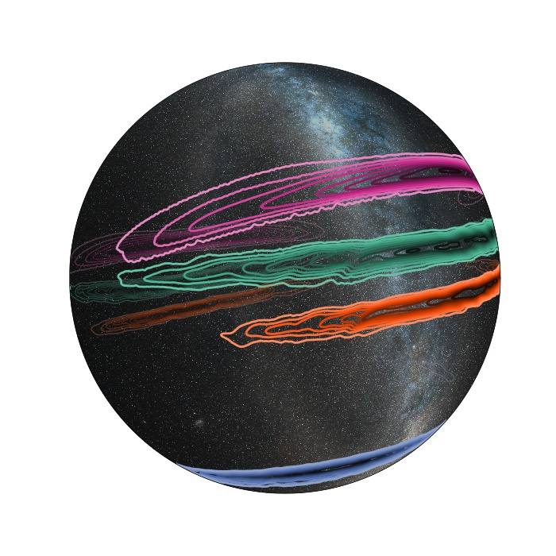
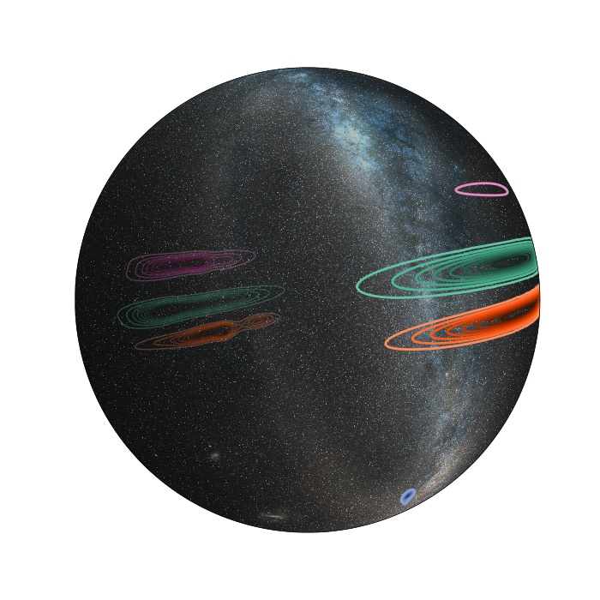
GW170104 Paper
Angular resolution plots for GW170104
LALinference sky localizations of three O1 and one O2 binary black hole signals: GW150914, LVT151012, GW151226, GW170104. The four events were localized to 90% credible areas of about 600, 1600, 1000, and 2000 deg2 respectively. Also shown are examples of simulated BAYESTAR localizations of these events with Advanced Virgo (BNS range 36 Mpc). For these examples, the hypothetical additional Virgo data would shrink the 90% credible areas to 10-20, 1000, 600, and 400 deg2 respectively.

