Slide 1
AdV VAC design meeting
Cascina, 19 July 2011

Slide 2
Agenda
first discussion about vacuum design of central area - and pickoff chamber design in particular - is scheduled for Tue19 Jul, from 17h to 18h30. Time will be short, some topics are:
1_ general msrc vacuum design in central area , Antonio + All
2_ pickoff chambers discussion, PR one in particular, Lapp + All technical points: size needed, space constraints, other design options, clean tent, access req.ts, pumping , possible evolution (cryotraps...?)
3_ interface between vac teams / tasks (sharing of works on the platform in particular) All
4_ non VAC works definition, All
we shall have a free discussion, slides can be put here: https://workarea.ego-gw.it/ego2/virgo/advanced-virgo/vac/central-area-vacuum-system/19jul-meeting/ The 'meeting room' room is reserved from 16h, so we shall anticipate discussions on technical points of not general interest, such as orings of cryotraps or other details EVO coordinates will follow

Slide 3
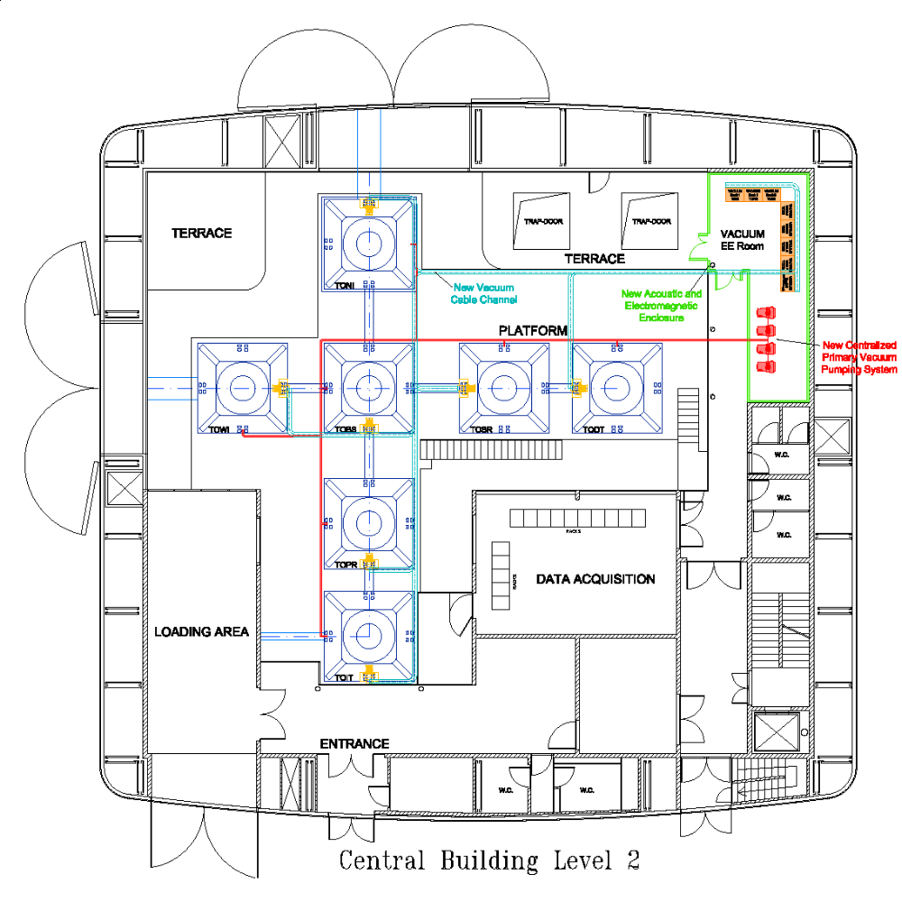
MSRC Central area vacuum system:
Pumping system on links study is in progress, along with beams definition
Try to keep the link PR-BS ‘free’ from apparatus to gain space for the P.O. chamber
Some spare ports, big one on PR-BS in particular, for a future ‘cryopump’
Need to discuss DET/INJ links design .
M
ti
ti
T
C
Measurement
Turbo group
Ion group
Brewster/trap
TSP, existing
Remote scroll
Cryogenic signals
M
I
T
ti
T
I
I
I
M
R
ti
C
I
T
?
T
I
?
T
ti
T
R
I
?
C

Slide 4
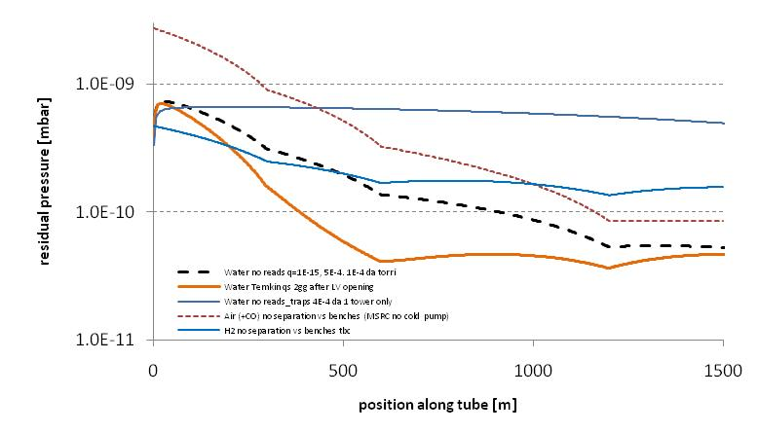
Pressure profile along 3km pipes in an example of MSRC configuration: pay attention to air coming from towers (permeation ).
All pumps ON, no cold pump, no INJ brewster, no helicoflex seals...

Slide 5
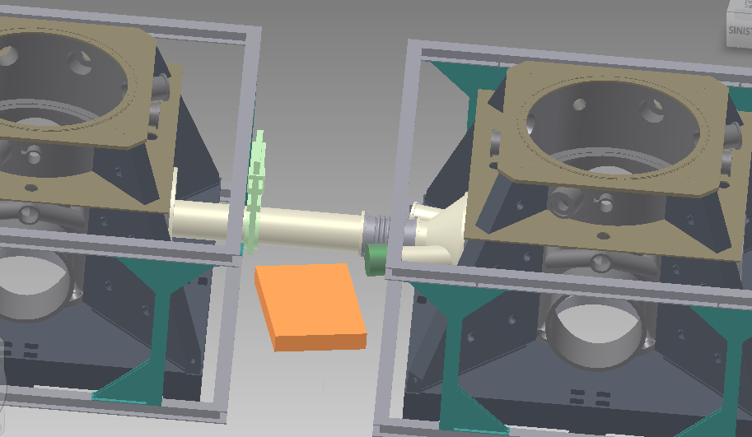
PR pickoff chamber Good to use one single design if possible… Proposed design seems at limit: a ‘brewster’ section ~400mm long should normally be added (here in green): can be integrated ‘inside’ the chamber?
A rectangle 1x1.4m is shown here as example. Other constraints to be considered are: valve (maybe inside the oven tbc) cable trays on the floor, ovens additional stiffening bars (see next pic), gauges , towers position tbd (note: ‘oven rotation’ seems not needed )

Slide 6
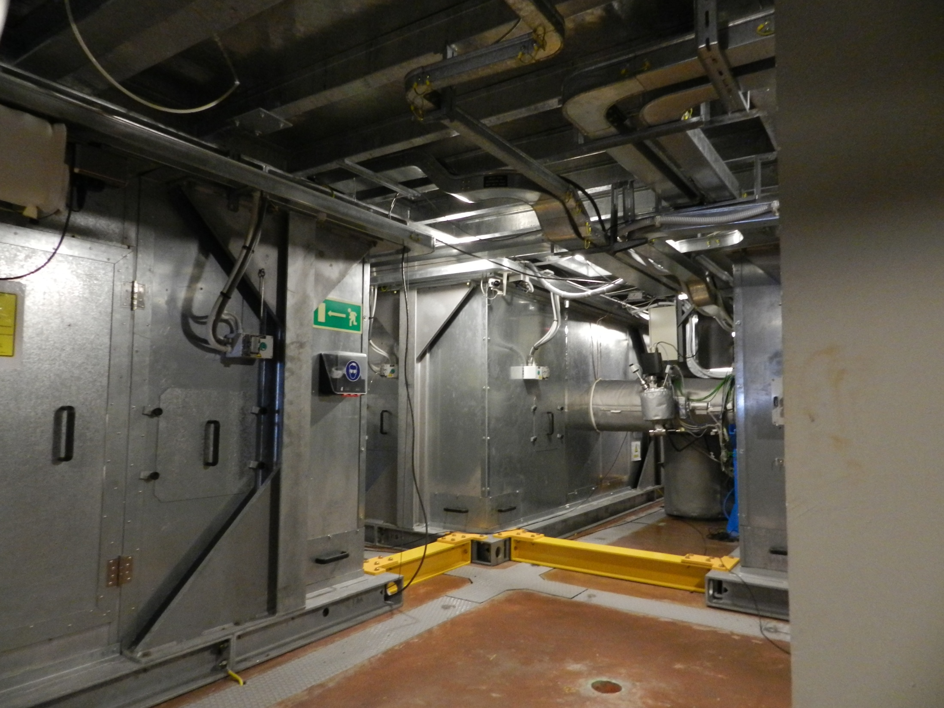
Single stage sas chamber could be fit below the platform? Drawbacks: difficulties for SAS access? Same design also for INJ lab? Or minitower could be optimized (eventually modifying the end chamber design too)

Slide 7
Vacuum requirements proposal : ~1 mbar , static vacuum
1) Better if ready to allow a future pumping system for high vacuum : Turbo and related CTRL system …
Keep the possibility to eliminate the ‘brewster window’ in the future? Special ‘trap’, or cryogenic pump would be needed… Space constraints to be considered: a second ‘steering mirror’ chamber could be installed to move away the PR chamber and gain space in a second time? Other possibility is a cryopump on the link...
In case the design of the chamber and the inner components have to be UHV compliant

Slide 8
Starting AdV on-site works:
First on-site operation is tower displacement, that interfaces with other works
within VAC we need discussion about the new vacuum chambers, at first the central hall ones:
Envisaged size and required platform modifications (drawings to be circulated)
Envisaged installation times procedure
non.-vac req.ts clean air flow rate, tent class, ...
...
They impact also on links ,valves, new pumps and related central area modifications. Internal meetings within VAC could be early September.

Slide 9
Platform
Ovens
modified platform
parts
Ovens modifications:
Cryotraps
links
Aperture for PR-P.O
Platform modifications:
Tower displac
Apertures for valves
Aperture for PR-P.O .
Non VAC
works
?

Slide 10
Proposed Tasks sharing
Cryotraps Nikhef
Enlarged Links EGO / TBC
Pumping system upgrade EGO
Vacuum valves Nikhef
New vacuum chambers Lapp
Towers displacement EGO
Control System LAL
Platform modification EGO
SR towers upgrade LAPP

Slide 11
Possible additional Tasks tbd
Cold pump EGO/Genova/tbc
Brewster windows of new chambers Lapp
Beam dump chamber? tbc

