Slide 1
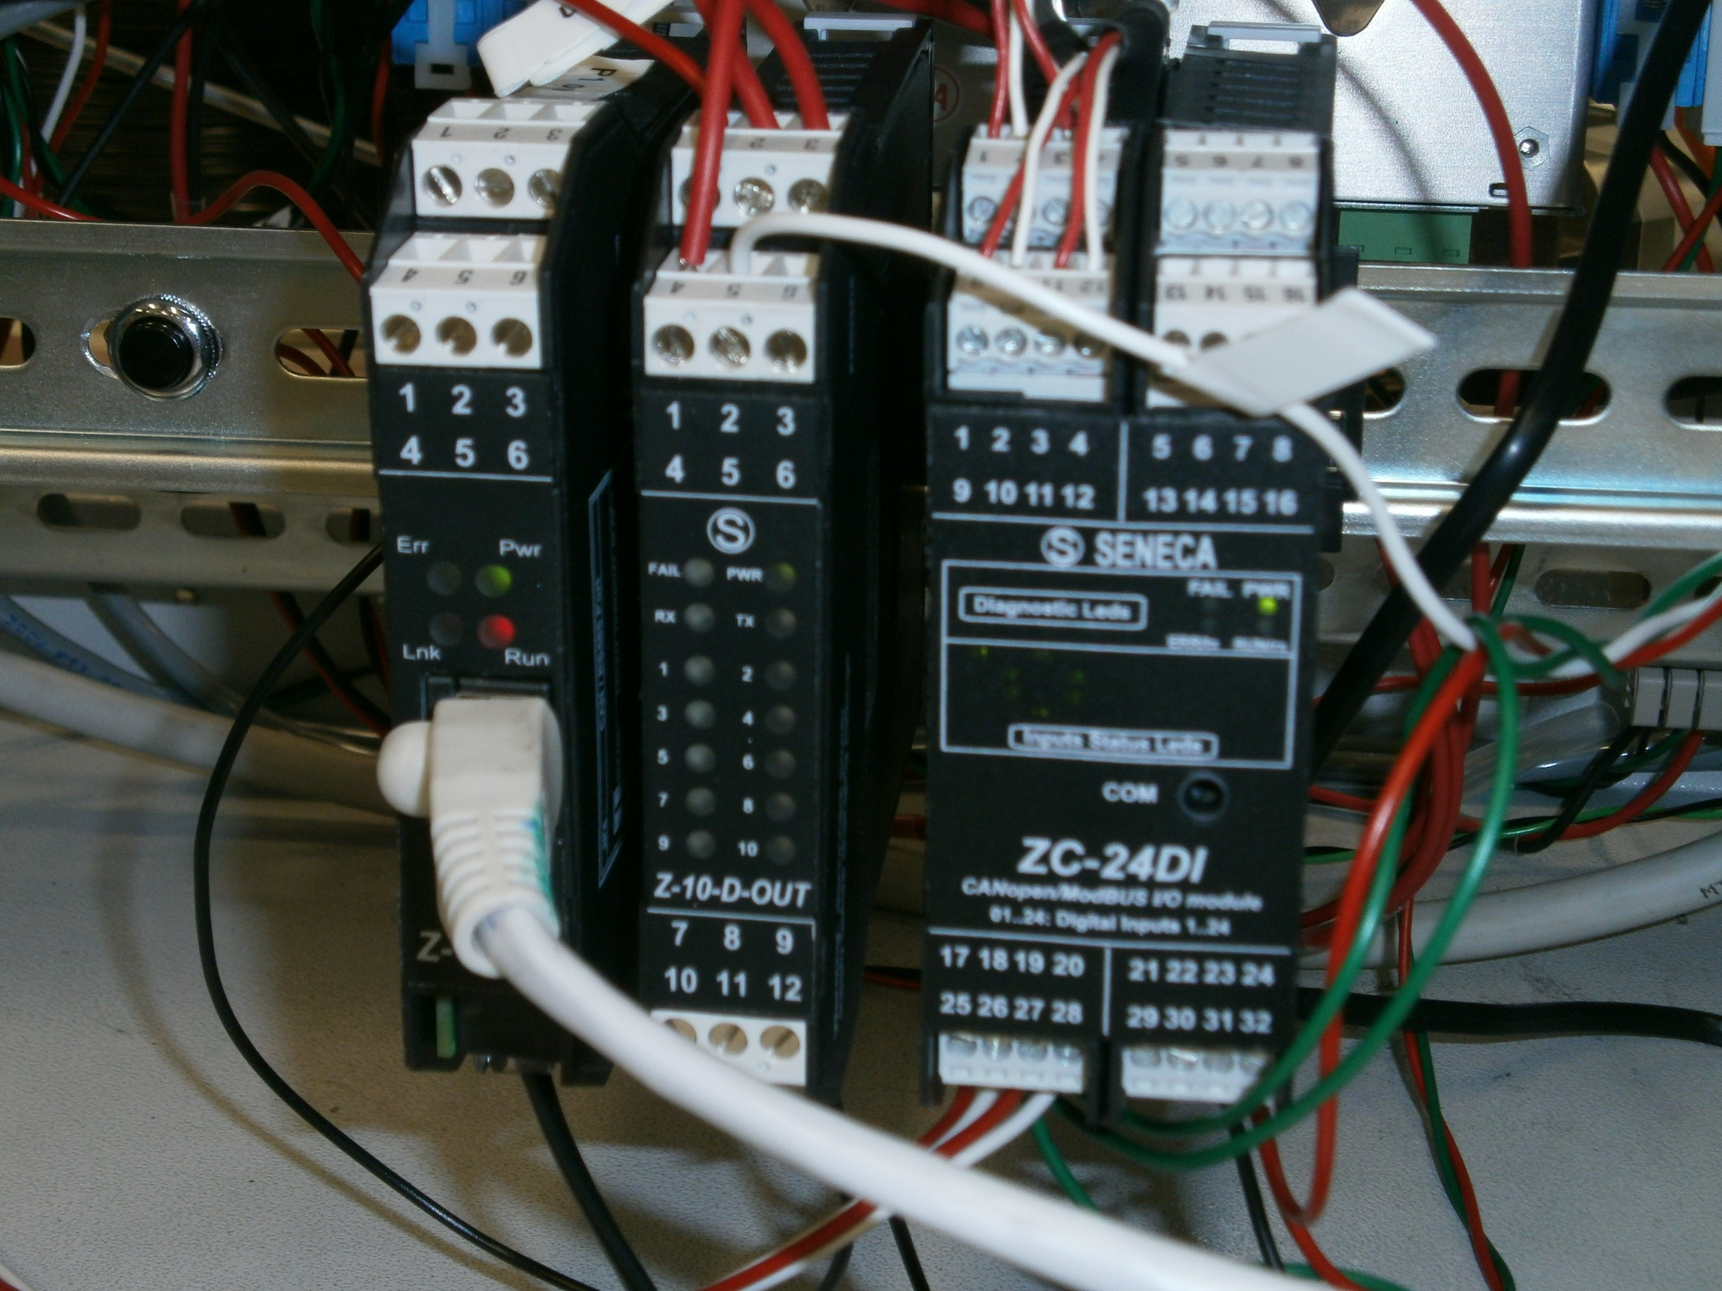
PLC for CryoTrap Control Test (CT²)
Giulio Ballardin for Software Group
Meeting 27 April 2012

Slide 2
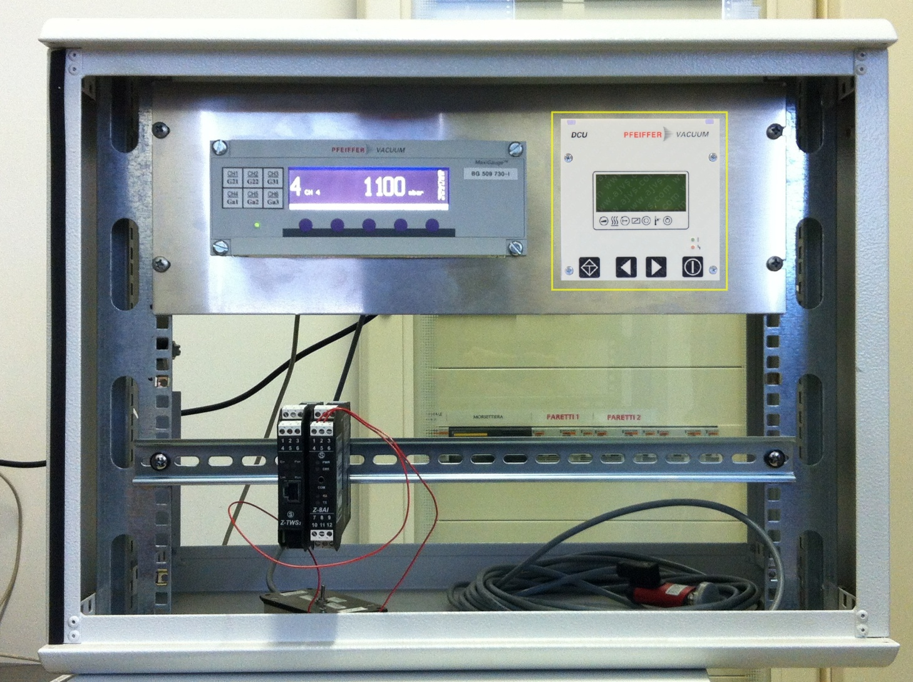
Prior Status (VTF) (9/2/2012)

Slide 3
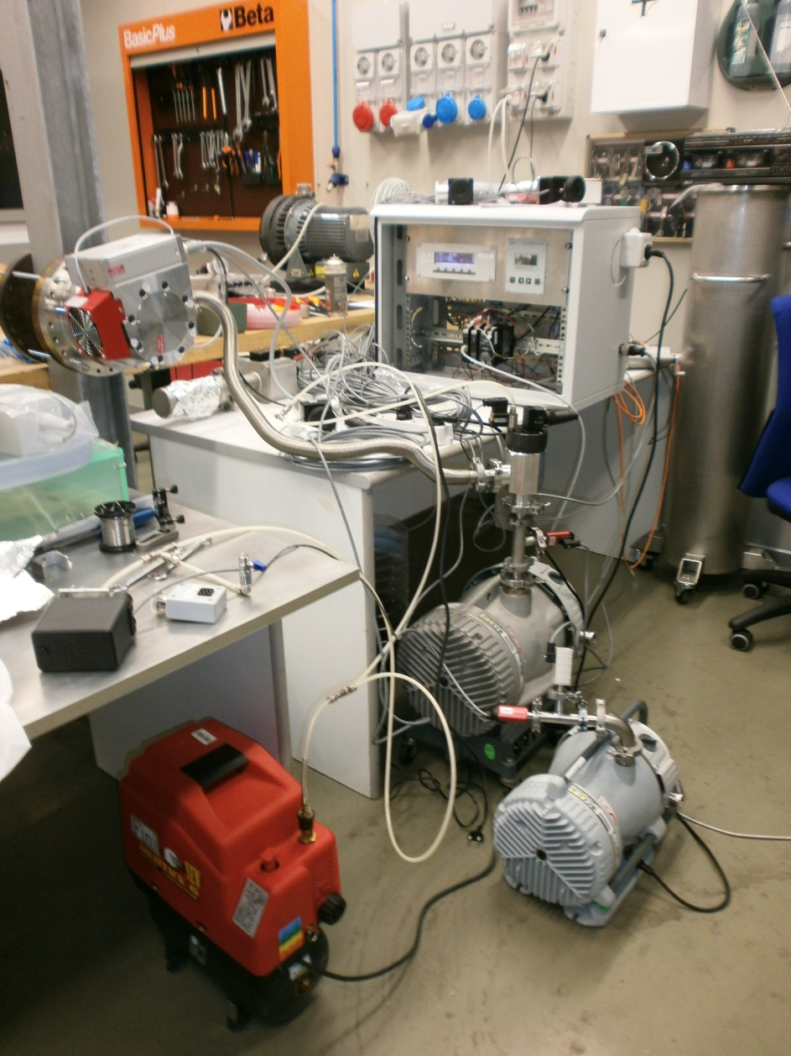
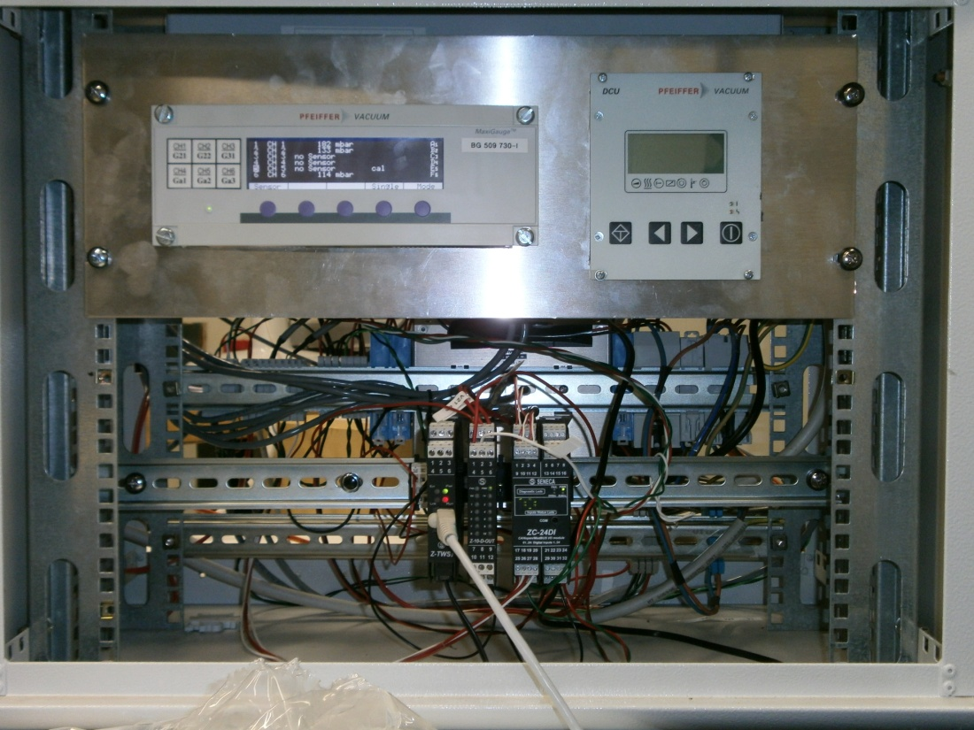
Present Status (1500 North)

Slide 4
PLC + Software costs
PLC: Seneca Z-TWS3-C 570 €
ZC-24DIN 138 €
Z-10-DOUT 79 €
Software Codesys 0 €
Software Z-Net3 (Seneca) 0 €
_______________________________________
Total 787 €
For more information: http://www.seneca.it

Slide 5
Deadlines
As declared in the precedent presentation, we finished our work at the end of March 2012.
During this month, we added a new manual pump (V2), and we tested again all the system at 1500 North.

Slide 6
Comunication
We use the Linux library libmodbus v3r0p1
ModBus RTU
Windows
MODBUS TCP-IP
Tango
Linux (SL)

Slide 7
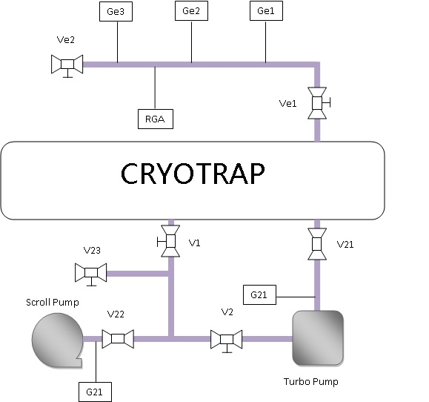
CryoTrap Scheme

Slide 8
Architecture
There are tree architecture/security levels:
Electronic (for more info R. Cavalieri)
PLC
Software (Tango: Martin Mohan)
Software
PLC
Electronic

Slide 9
WEB Interface
The Z-TWS3-C is also a WEB server. So it was possible build a WEB UI to test CryoTrap control system at low level.

Slide 10
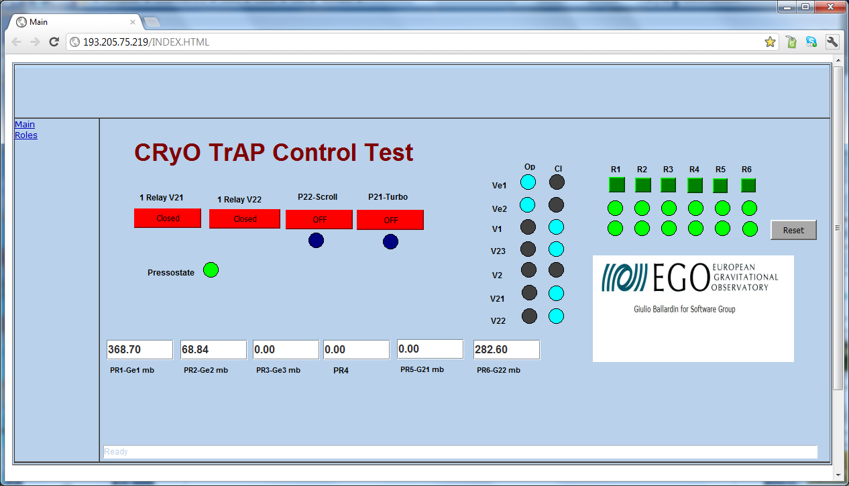
WEB Interface

Slide 11
Problems
Initially I found some problems in using both PLC and ZC-10DOUT. These problems were solved with Seneca’s help.
There is a problem with the web user interface. The memory usage of Jave (TM) increases until the browser freezes after an hour. I’m investigating this problem.

Slide 12
Possible improvements
Add a A/I Module to read the operating frequency of Turbo pump.

Slide 13
What is necessary for the installation at Nikhef?
1)If you want to connect the Control System to the Internet:
IP address for PLC (mandatory)
IP address for TANGO machine (mandatory)
A Linux account in a machine at Nikhef reachable from Cascina (optinal)
2) You can connect the laptop running Tango directly to the PLC.

Slide 14
END

