Slide 1
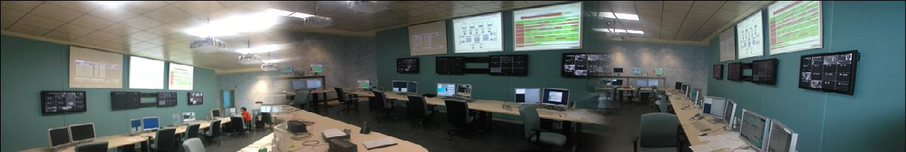

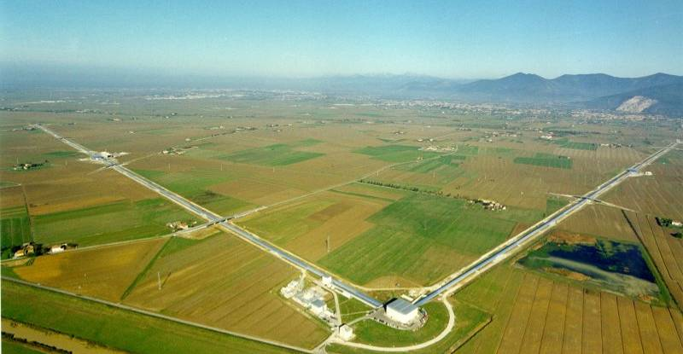
The quest for gravitational waves

Slide 2
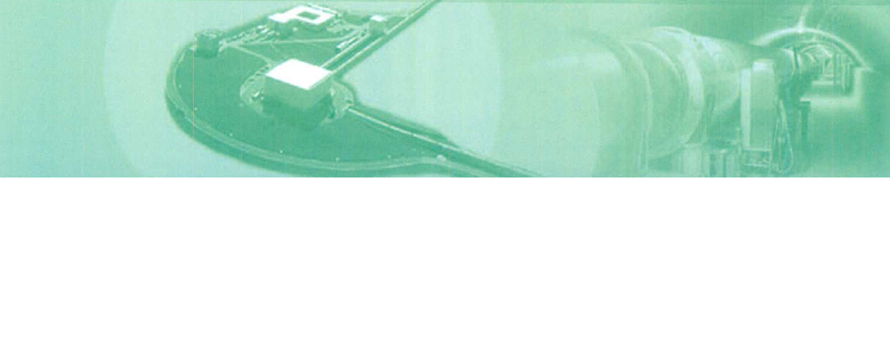

Gravitation: EU Excellence
Kepler, Ticho Brahe, Copernicus
Galileo, Newton
Einstein, Eötvos
Amaldi & the resonating antennas
The era of interferometers:
  GEO600 & VIRGO in EU
LIGO in USA, TAMA in Japan
An active field:
Advanced detectors (VIRGO, LIGO, GEO600)
LCGT in Japan
IndIGO in India
Australia
...

Slide 3
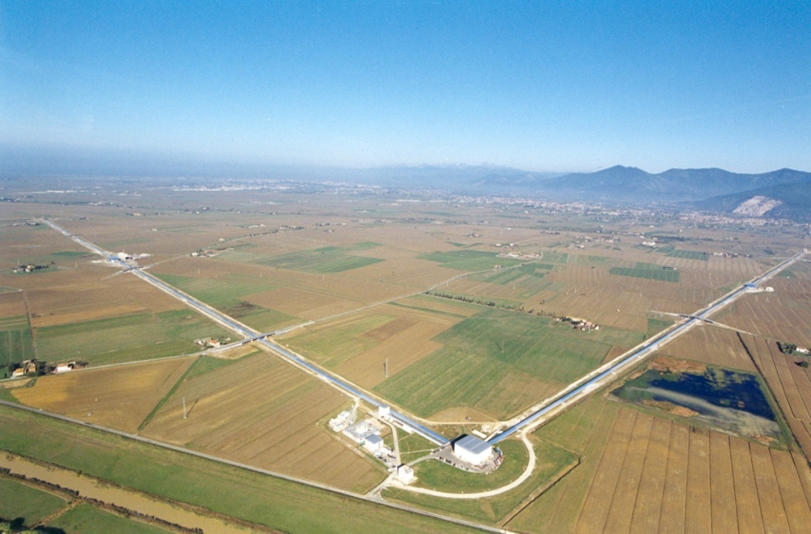
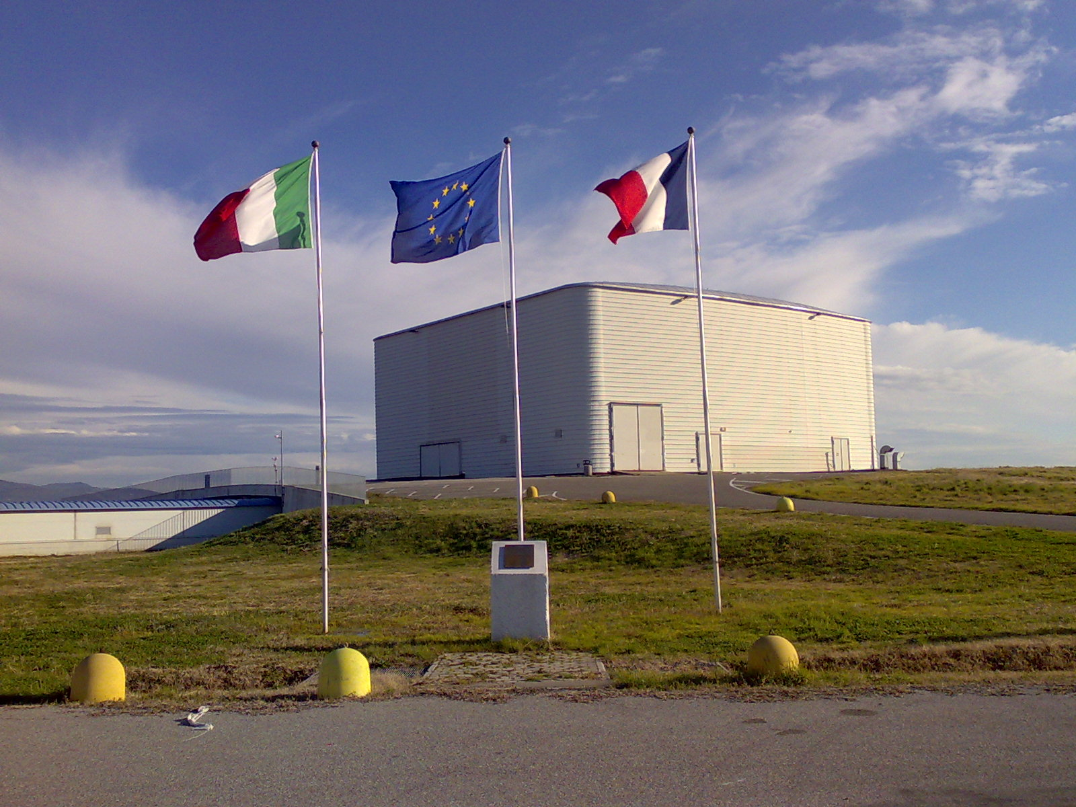
EGO in synthesis
EGO:
French-Italian Consortium to support & operate VIRGO
and
promote cooperation on Gravitational Waves physics
in Europe

Slide 4
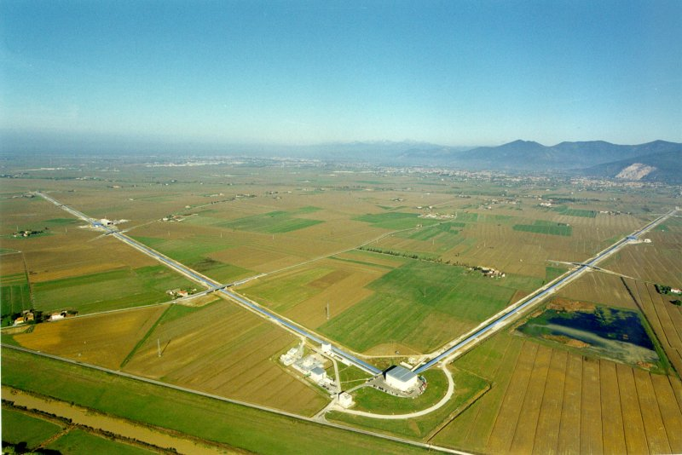
EGO/VIRGO
A large infrastructure :
3 km long arms: ΔL / L = 10⁻²¹
60 ha of land; ~150000 m³ of buildings
The largest high vacuum system in Europe : 7000 m³ P ≅10⁻⁹ mbar
High tech optics
Several class 10 clean rooms ; 15000 m³ thermo stabilized to +- 0.2 °C
600 kW electrical power
24h/24h data taking; 1 TB/day collected

Slide 5
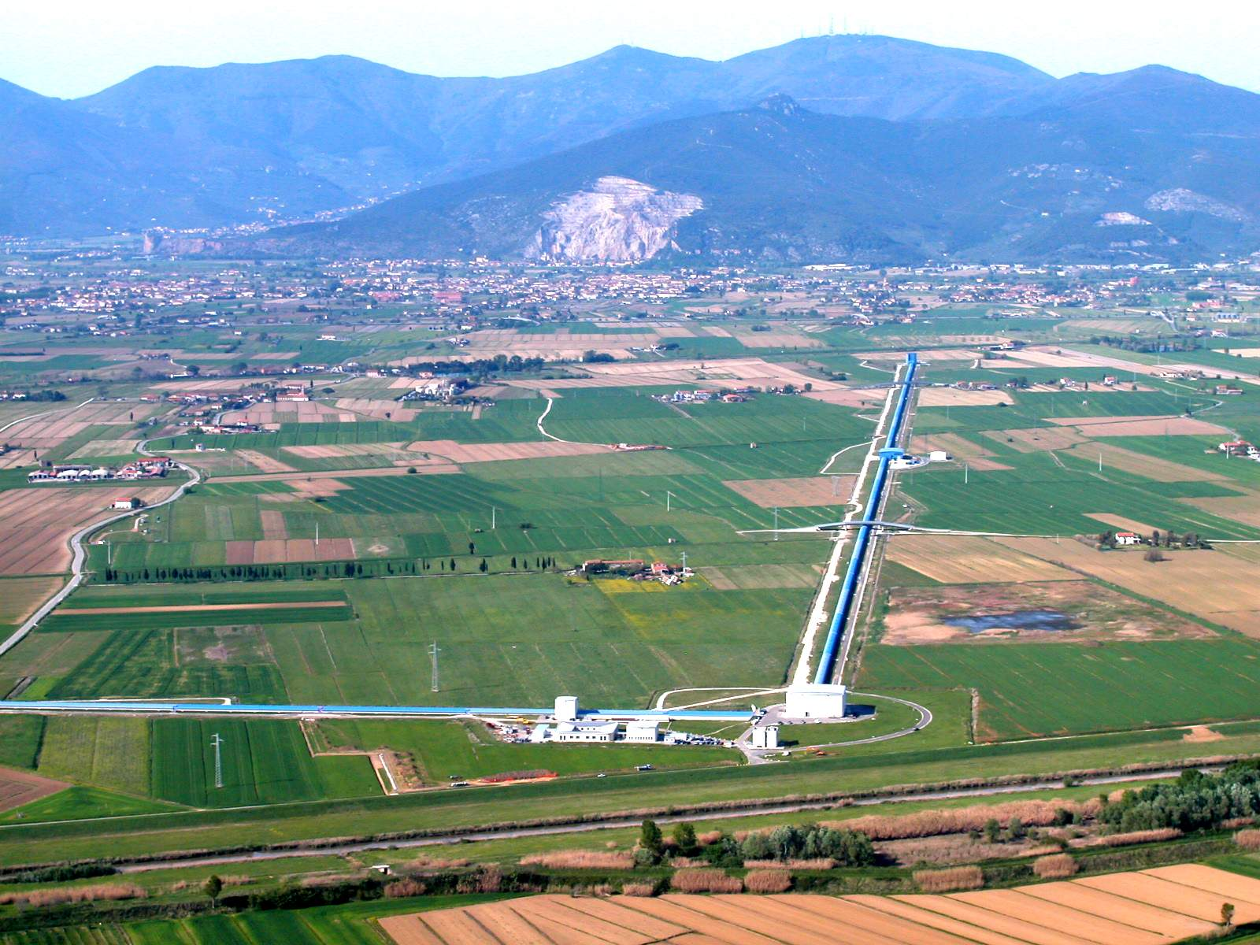





EGO / VIRGO
LAPP – Annecy
NIKHEF – Amsterdam
RMKI - Budapest
INFN – Firenze-Urbino
INFN – Genova
INFN – LNF
LMA – Lyon
INFN – Napoli
OCA – Nice
LAL – Orsay
APC – Paris
LKB - Paris
INFN – Padova-Trento
INFN – Perugia
INFN - Pisa
INFN – Roma 1
INFN – Roma 2
POLGRAV - Warsaw

Slide 6
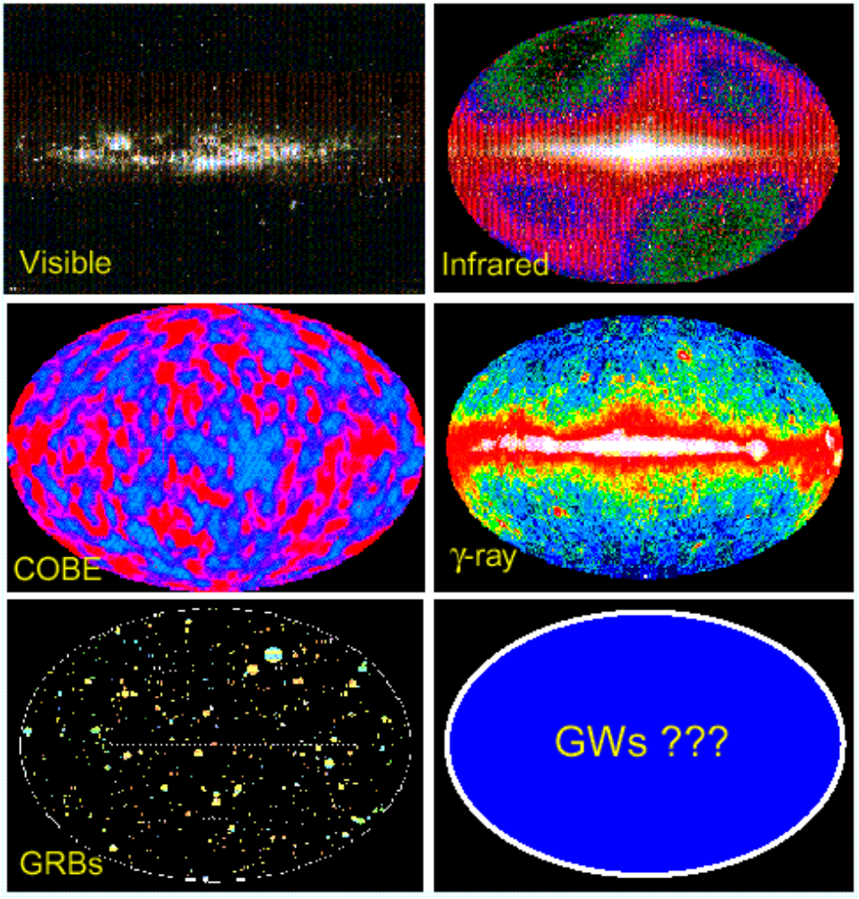
The Scientific Motivation
The Universe has been studied essentially through EM radiation.
GWs have a different origin.
A view complementary to the results of CERN & ESO

Slide 7
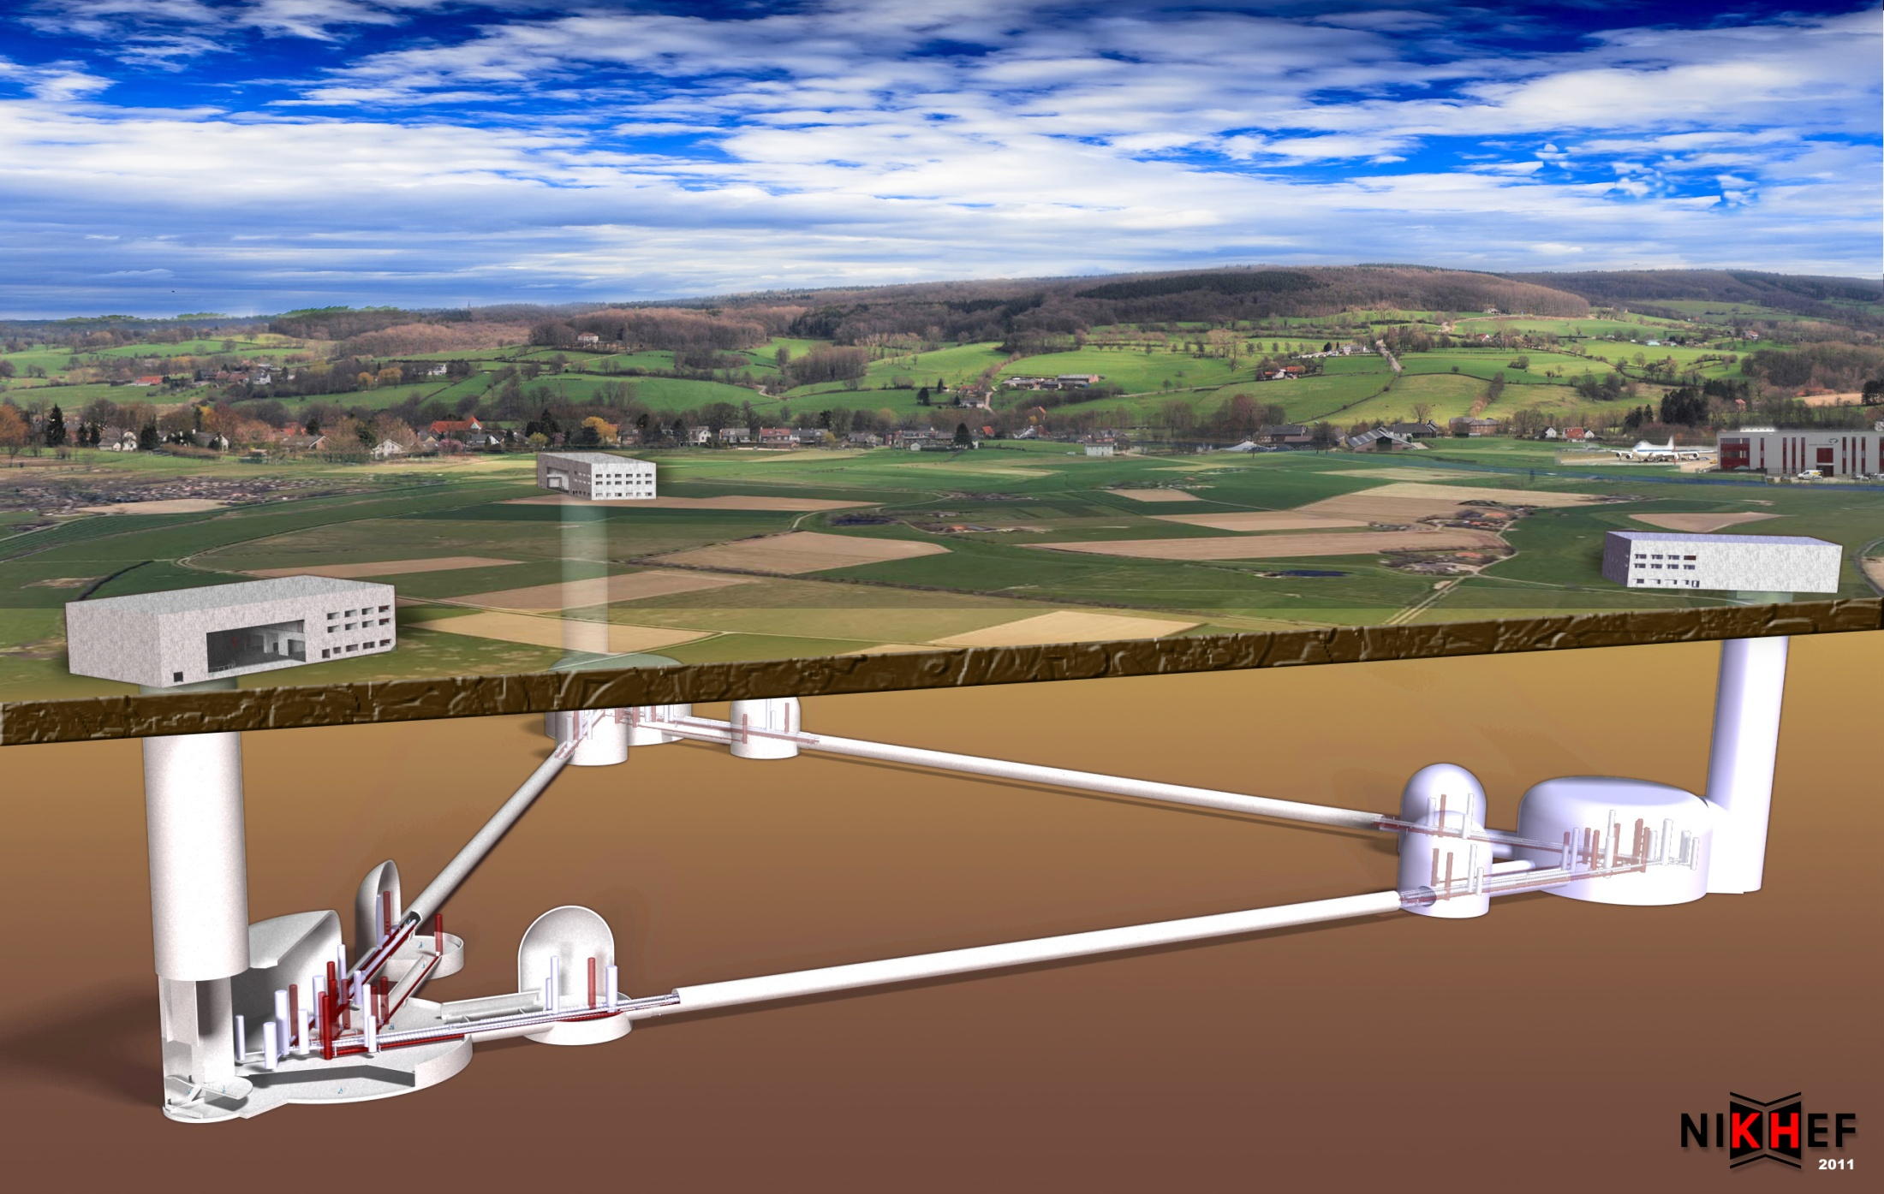

Einstein Telescope
ET will be a 3rd generation GW observatory
  Science targets on Cosmology, General relativity. Astrophysics and fundamental physics, completing the multi-messenger observation of the Universe
  ET will be a large European research infrastructure that, during the first years of its life, will collaborate with the existing GW detectors and then will be embedded in a worldwide network of similar observatories

Slide 8
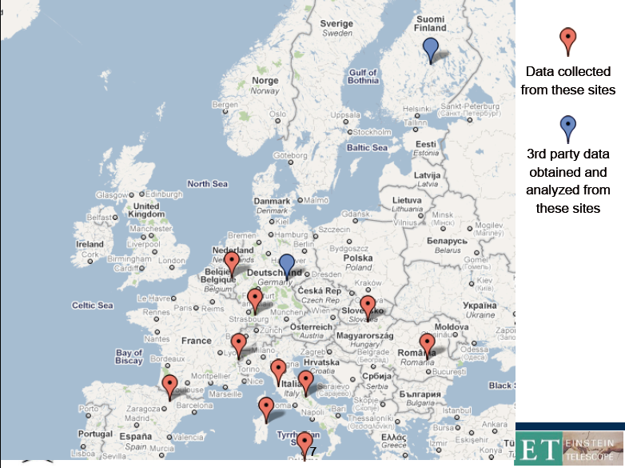
ET: the research infrastructure
The site for ET has specific requirements, the search for a compliant location has already started
The observatory will host up three detectors and will allow sequential installations and upgrades

Slide 9
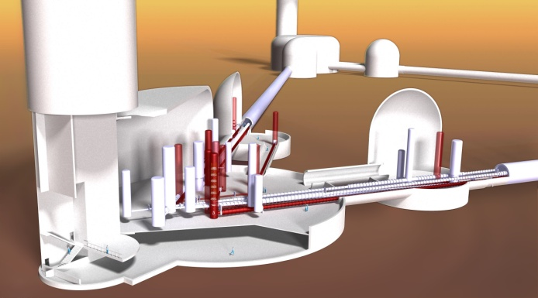
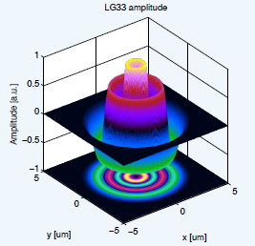
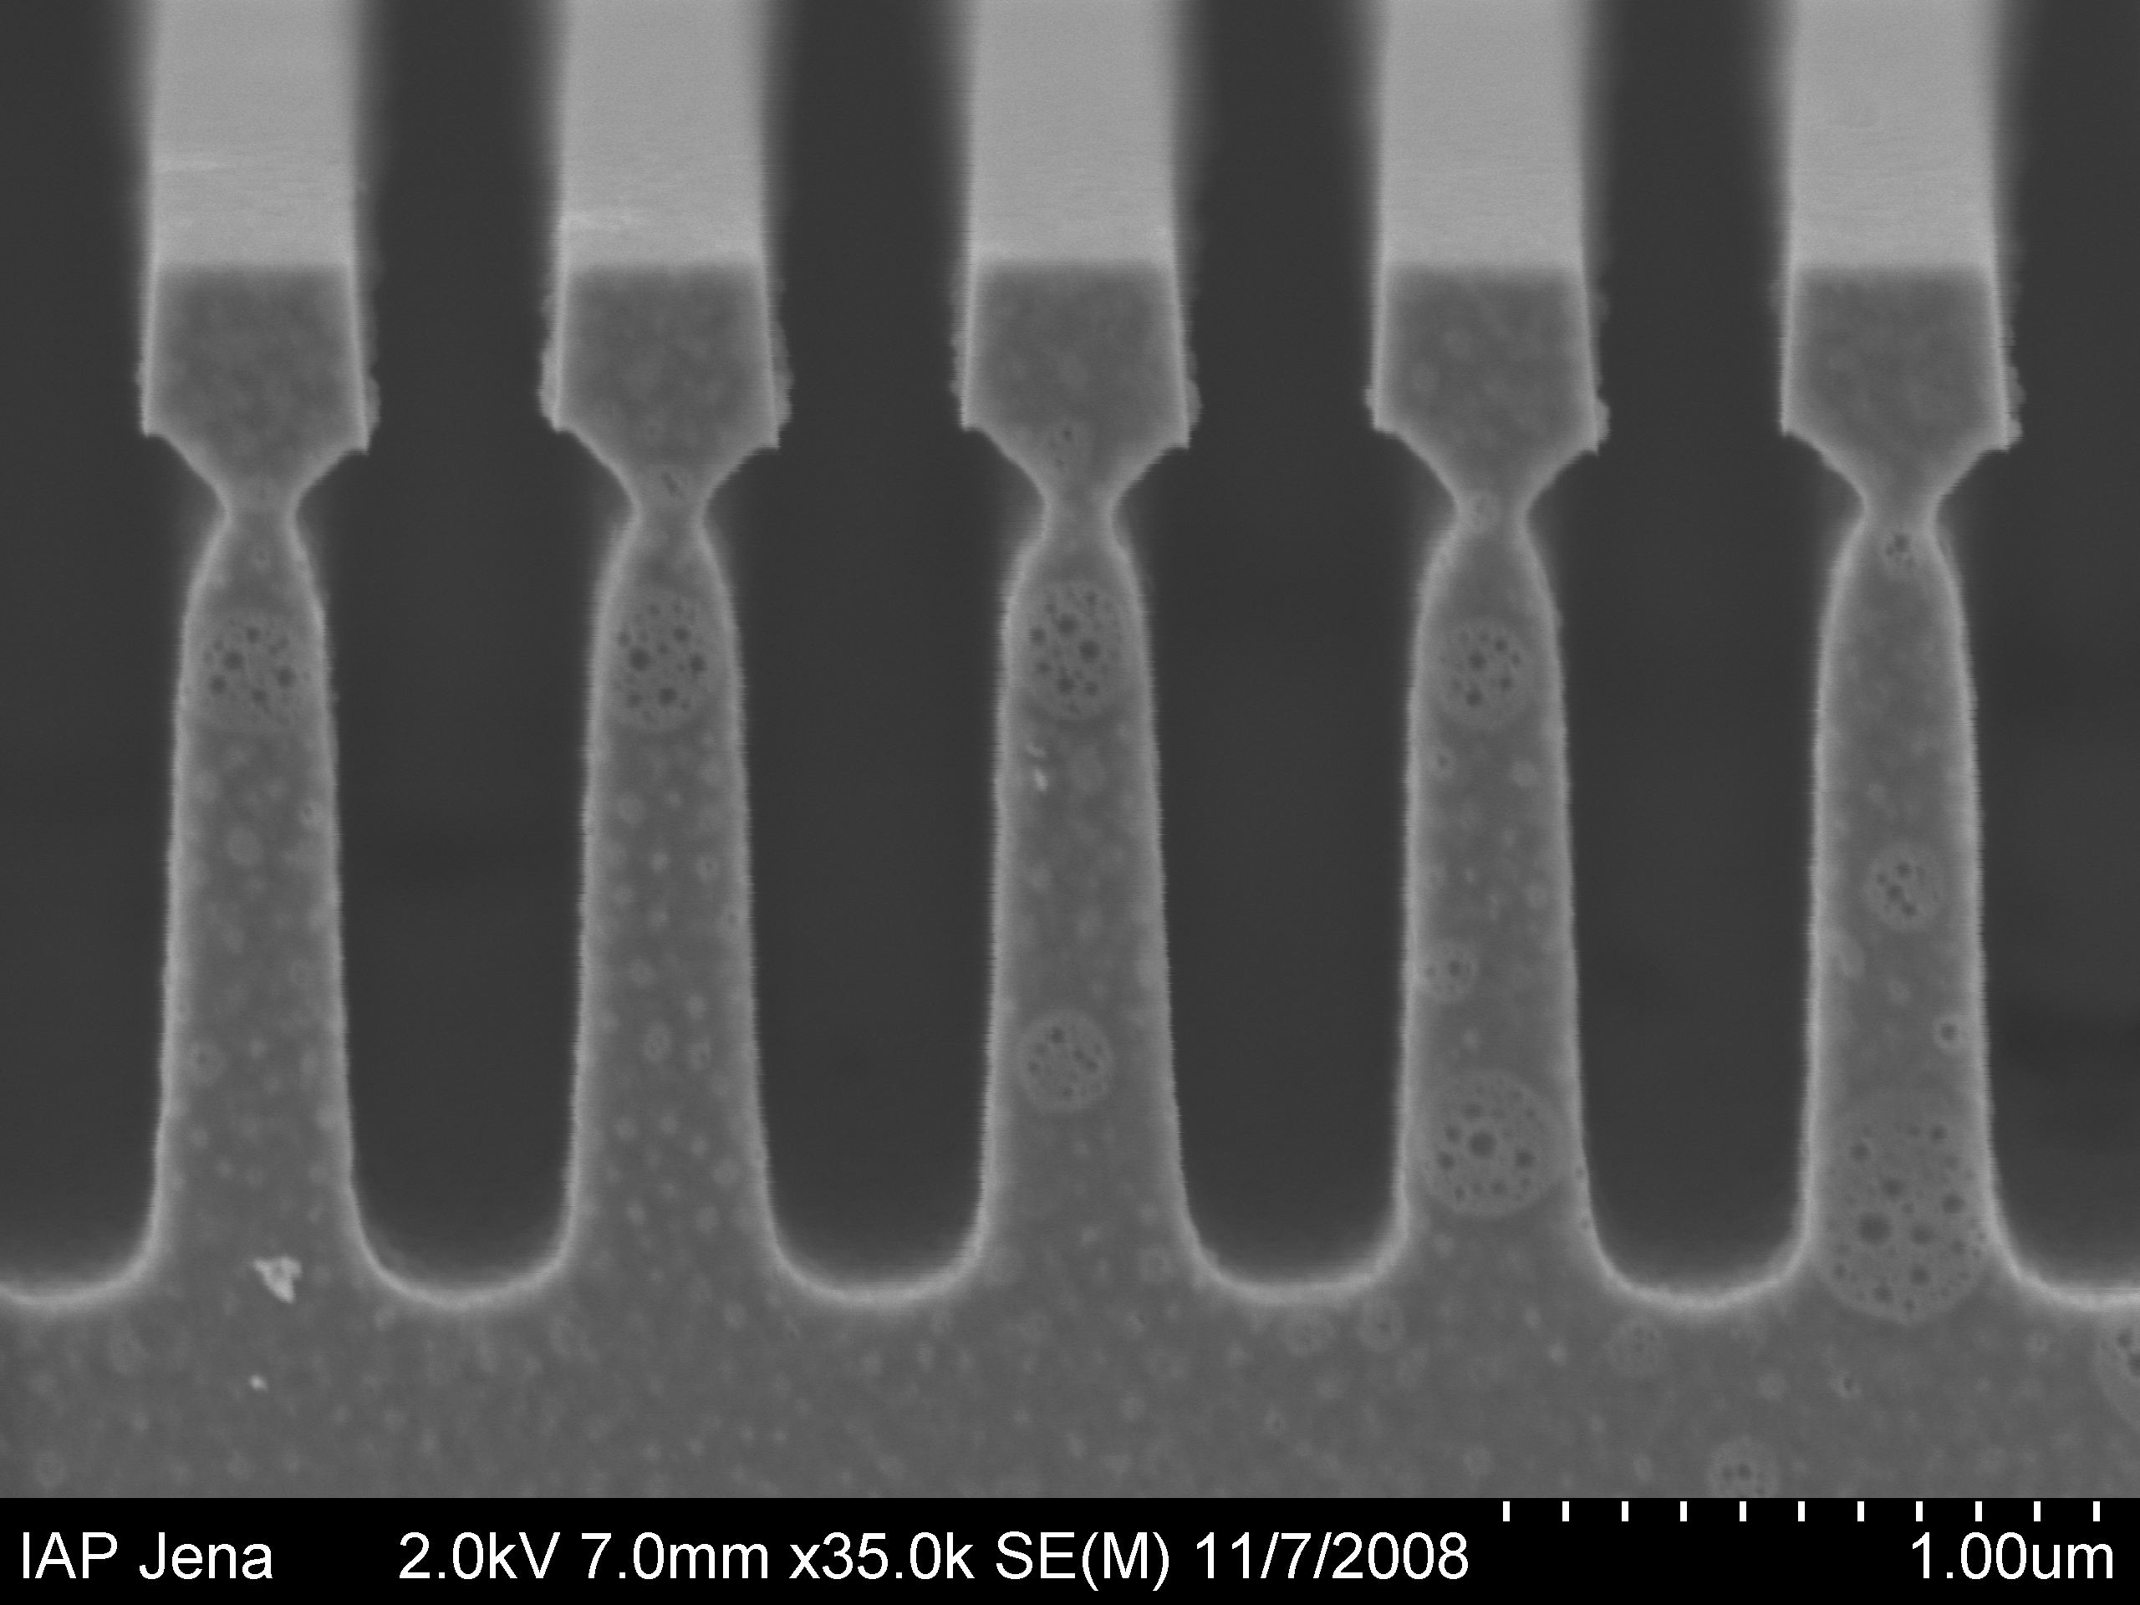
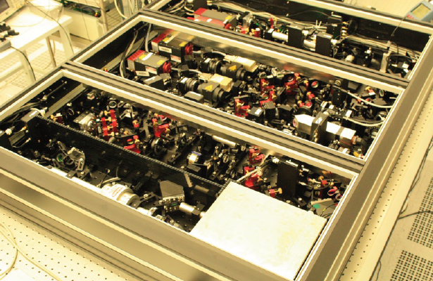
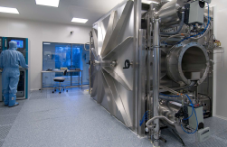
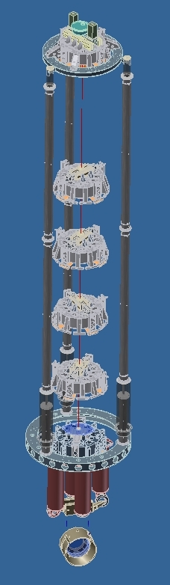
ET network
ET will be located in Europe
Initially it will collaborate with the second generation GW detectors, then it will use the technologies tested in that apparatuses
National laboratories are studying and developing the technical solutions for ET and performing the data analysis

Slide 10
ET: technology developments
To improve the sensitivity of the GW detectors at the level requested by ET a huge technology development program is required, with intense know-how exchange with the industries:
  Cryogenics
    Low vibration noise cryo-coolers
  Precision mechanics
    Seismic noise filtering
  Optics
    Low absorption silicon and silica optics
    Very low scattering polishing
    High quality dielectric coatings
    Nanotechnologies for coatings
    Quantum optics
    Simulation
  Lasers
    High power, low noise 1064 nm lasers
    Low noise 1550 nm lasers
Mirrors & Lasers
ASPERA-Industries workshop
21-22 October 2011
EGO/Virgo site

Slide 11
Present of GW research in Europe
There is a scientific case
There are scientific and technological competencies, developed locally in Laboratories
There are research infrastructures, thanks to the vision of National Agencies
There are industries which have produced the high-tech components, acquiring know-how to be spent on the market
There are first class World-wide technology transfers and/or spin-off from EGO/VIRGO and GEO600: (a) mechanics (IT), (b) lasers (DE), (c) mirrors (FR & DE)
The two EU interferometers started one week ago to explore the sky together, in a scientific run with the highest sensitivity ever reached
The National scientific communities have demonstrated to be able to cooperate on a common project (the Einstein Telescope)
There is a well consolidated management (EU grants, EU projects, science and technology workshops, R&D, training)

Slide 12
An EUROPEAN STRATEGY for GW?
A paradigmatic case?
EGO & GEO600
A multi-sited Research Infrastructure?
Lead 3rd Generation Interferometers?
Local & Global
The virtuous quadrilateral:
Research
Technology Collaboration
Education

Slide 13


Summary
An efficient, responsive and light structure to support Virgo and promote European collaboration under supervision by national institutions
EGO existence relies on Virgo/AdV success
The future of GW in Europe depends upon a stronger collaboration between EU countries. EGO may prefigure the required infrastructure.
Advanced VIRGO

