Slide 1
Virgo + Global Control
Introduction to the new operation procedures

Slide 2
Introduction
Today, the new GC is in an intermediate state
    Some old Rio Photodiod Pr still in operation
    Gateway from Tolm→ Dol world for DSP
We will tell about the new features (client Cl, new servers, cpu machine location)
We will give basic recovery procedures

Slide 3
The situation today
Pr29,28,(29,70,80 replaced recently by ADC7674)
VME
RIO
Tolm
ADC
VME
DOL
RIO
DSP
Qr34,Qr72,Qr82
VME
RIO
Tolm
ADC
RIO
Tolm
VME
DOL
PC
RACK
RTPC
GC_GTW1/2
Rio36a,rio38a
C36
→ DAQ room
PrITF,GcLocking, rtpc06
GcAlignment rtpc20
,
→ Computing room

Slide 4
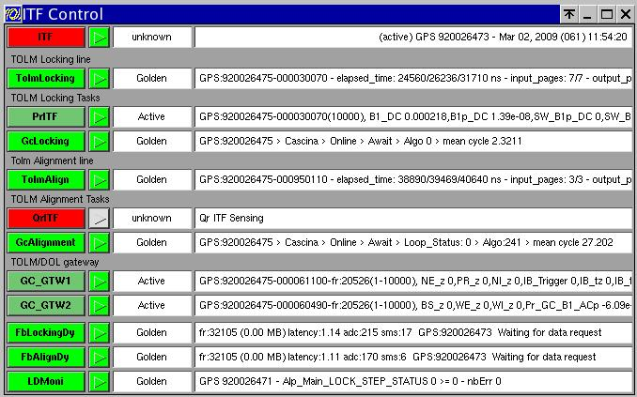
NEW ITF operation client
ClITFCtrl.cfg (in the locking menu)
Packet
configuration
rtpc06
rtpc06
rtpc06
ITF critical
rtpc20
rtpc20
rio36a
monitoring

Slide 5
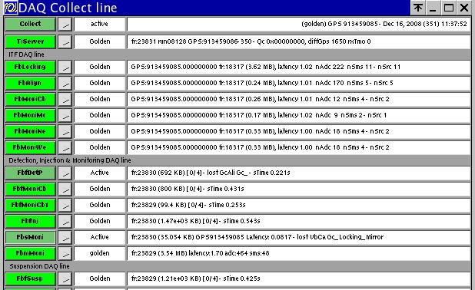
DAQ : ClDaqCollect client (part 1)
Tolmframebuilders
rtpc06
rtpc20
rtpc17
rtpc14
rtpc12
DAQ Critical:
FbLocking,FbAlign
→Pr channels
→Gc channels
rtpc13

Slide 6
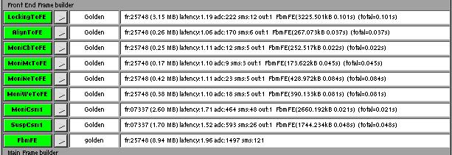
DAQ : ClDaqCollect client (part 2)
TolmConsumers
rtpc06
rtpc06
rtpc20
rtpc20
rtpc17
rtpc17
rtpc14
rtpc14
rtpc12
rtpc12
rtpc13
rtpc13

Slide 7
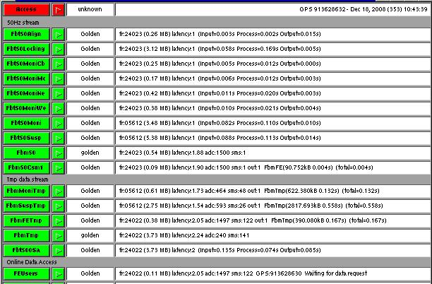
DAQ : ClDaqData client
rtpc20
rtpc06
Tolm50Hz
rtpc17
rtpc14
rtpc12
rtpc13
DAQ Critical:
FbLocking,FbAlign
→Pr channels
→Gc channels

Slide 8
Recovery procedure
Server crash
  → RESTART from menu
  case : GC_GTW
    Sometimes does not restart from menu
    Check cm name (cleanup)
    Log into rio36a,rio38a
/virgoDev/Pr/v10r06/${UNAME}/Pr.exe /virgoData/Pr/GC_GTW1/2.cfg
Machine crash :
  REBOOT MANUALLY
  RESTART servers from menu

Slide 9
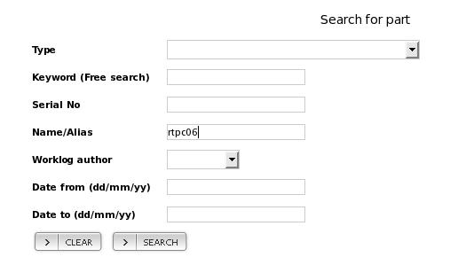
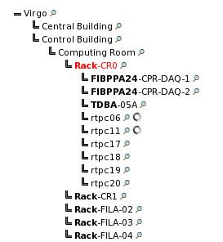
HWII information
Search for a CPU machine
2) Localize cpu machine

Slide 10
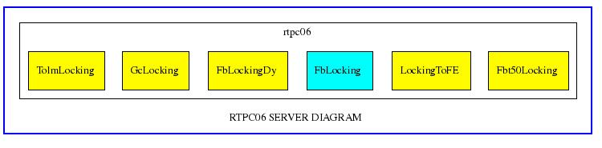
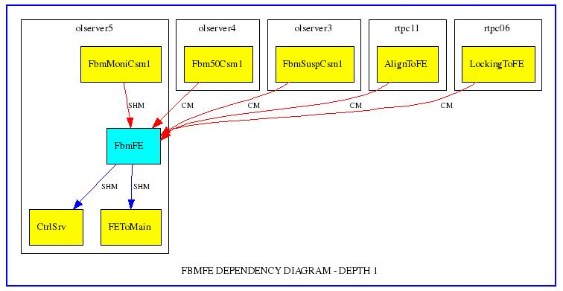
HWII server information
1) Look for CPU server list
2 ) Look for CPU
server dependencies

Slide 11
Tolm Monitoring tools
In TolmBase :
  TolmDaqSpy.exe returns list of packets with propagation times (not easy to use)
  Use dataDisplay with SMS like:
  Daq_Lock_<RECEIVER>_<SOURCE>_Tolm_Send
  → Data quality Monitor implemented with thresholds (see Global Control )

Slide 12
Hardware intervention
Optical topology contains:
ADC7674/MxDX/TOLM-PMC/TOLM-PCI
In case of propagation delay too important, check MxDx route:
  Get sender/receiver serial from HWII and Cfg files
  Use hwdbGetMxDxRoute.exe in /virgoDev/hwiiAPI
  Locate ADC7674/MxDX/TOLM-PMC/TOLM-PCI with HWII

Slide 13
Scenari
  All optical links (transeiver) are green and blinking → Reset MxDx
  Find a transeiver green and still
  → Reboot attached RIO/RTPC
  Unable to reconfigure an ADC7674
  → check optical links route
  → try switch off/on ADC crate
  4) If nothing solves the problem :
  →substitute transeiver/optical cables

